Slide 1
RADISSON COLLECTION HOTEL, HYLAND SHANGHAI 上海丽笙精选海仑宾馆

Slide 2
AND CONTINUES HERE
CHINA - SHANGHAI
Paris of the East
Destination of history and vision, blending with modernity.
Renowned as the “ Paris of the East” , with its history of being the most prosperous city in the Far East during the 1930s, Shanghai is one of the world' s leading cities today, exerting influence over finance, commerce, fashion, and culture.
Located in the city center of Shanghai
ATTRACTIONS: The Bund 0.5 km People’s Square 0.2 km Shanghai Museum 0.2 km
CONNECTING TO THE AIRPORT:
Pudong International (PVG) – 50km, 1hour Hongqiao International (SHA)- 20km, 30mins METRO : Nanjing East Road Station and People’s Square Station located adjacent to Hotel (Line 1, Line 2, Line 8 and Line 10)
Title starts here
16 . Radisson Collection
Nanjing Road in 1930s

Slide 3
AND CONTINUES HERE
Radisson Collection Hotel, Hyland Shanghai
- Located on China famous Shopping Pedestrian Street – Nanjing East Road in the heart of Shanghai
Surrounded by shopping and entertainment outlets and historical sites.
The hotel is within walking distance to Shanghai' s most celebrated attractions, The Bund, People’s Square, Shanghai Museum, Shanghai Grand Theatre.
Free Internet Wifi access in whole hotel.
The Bund 0.5 km
People’s Square 0.2 km
Shanghai Museum 1 km
Shanghai Grand Theatre 0.2 km
Yu Yuan Garden 1.5 km
Xintiandi Scenic Area 2 km
Title starts here
16 . Radisson Collection
Nanjing Road in 1930s

Slide 4
AND CONTINUES HERE
Welcome to the Exceptional!
Radisson Collection Hotel, Hyland Shanghai offers 383 elegantly designed guestrooms and suites includes 100 characterful Collection Executive Rooms, located on 22nd to 29th uppermost floors with stunning views over a sparkling Shanghai city skyline
Other facilities includes 2 restaurants, 1 bar, 6 meeting space, a Fitness Center with Gym and Spa facilities
Free Wi-Fi throughout hotel
Title starts here
16 . Radisson Collection
Nanjing Road in 1930s

Slide 5
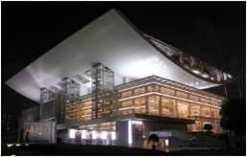
Surrounding Attractions 周边景点
Radisson Collection Hotel, Hyland Shanghai 上海丽笙精选海仑宾馆
Former French Concession
前法租界
Nanjing East Pedestrian Street
南京东路夜景
Shanghai Grand Theater
上海大剧院

Slide 6
Dive Into The Bed

Slide 7
Radisson Collection Hotel, Hyland Shanghai
上海丽笙精选海仑宾馆
Room Categories 房间类型 | Number of Rooms 房间数量
 | Twin 双床 | Queen 大床
Collection Room 丽笙精选标准房 | 54 | 82
Collection Superior Room 丽笙精选高级房 | 9 | 45
Collection Deluxe Room 丽笙精选豪华房 | - | 31
Collection Executive Room 丽笙精选行政房 | 26 | 74
Junior Suite 高级套房 | 2 | 18
Executive Suite 行政套房 | - | 40
Presidential Suite 总统套房 | - | 1

Slide 8
Collection Room
丽笙精选标准房
17 . Radisson Collection

Slide 9
Collection Superior Room
丽笙精选高级房
17 . Radisson Collection

Slide 10
Collection Deluxe Room
丽笙精选豪华房
17 . Radisson Collection

Slide 11
Collection Executive Room
丽笙精选行政房
17 . Radisson Collection

Slide 12
Junior Suite
高级套房
17 . Radisson Collection

Slide 13
Executive Suite
行政套房
17 . Radisson Collection

Slide 14
Executive Club Lounge
行政酒廊
17 . Radisson Collection

Slide 15
Wine & Dine

Slide 16
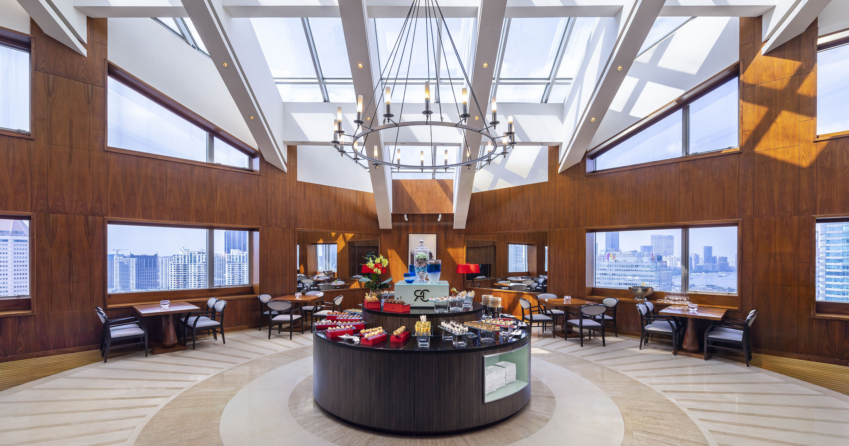
Restaurants & Bar 餐厅与酒吧
Radisson Collection Hotel, Hyland Shanghai 上海丽笙精选海仑宾馆
Mosaic Restaurant 莫赛克
Serves International Buffet and a la carte 供应自助餐以及零点
Operation Hours营业时间:
0630hrs to 2130hrs
Location地点:
Level 2 酒店二楼
Mao Chinese Restaurant 海茂厅
Serves authentic local and Cantonese cuisines 供应本帮菜以及粤菜
Operation Hours营业时间:
1100hrs to 1400hrs
1700hrs to 2130hrs
Location地点:
Level 5 酒店五楼
Hyland Pavilion 海仑阁
Serves beverages, afternoon tea and local cuisine
供应饮料，下午茶以及中餐
Operation Hours 营业时间:
1300hrs to 2300hrs
Location地点:
Level 30 酒店三十楼

Slide 17
Meetings & Events

Slide 18
Meetings & Celebrations 会议与宴请

Slide 19
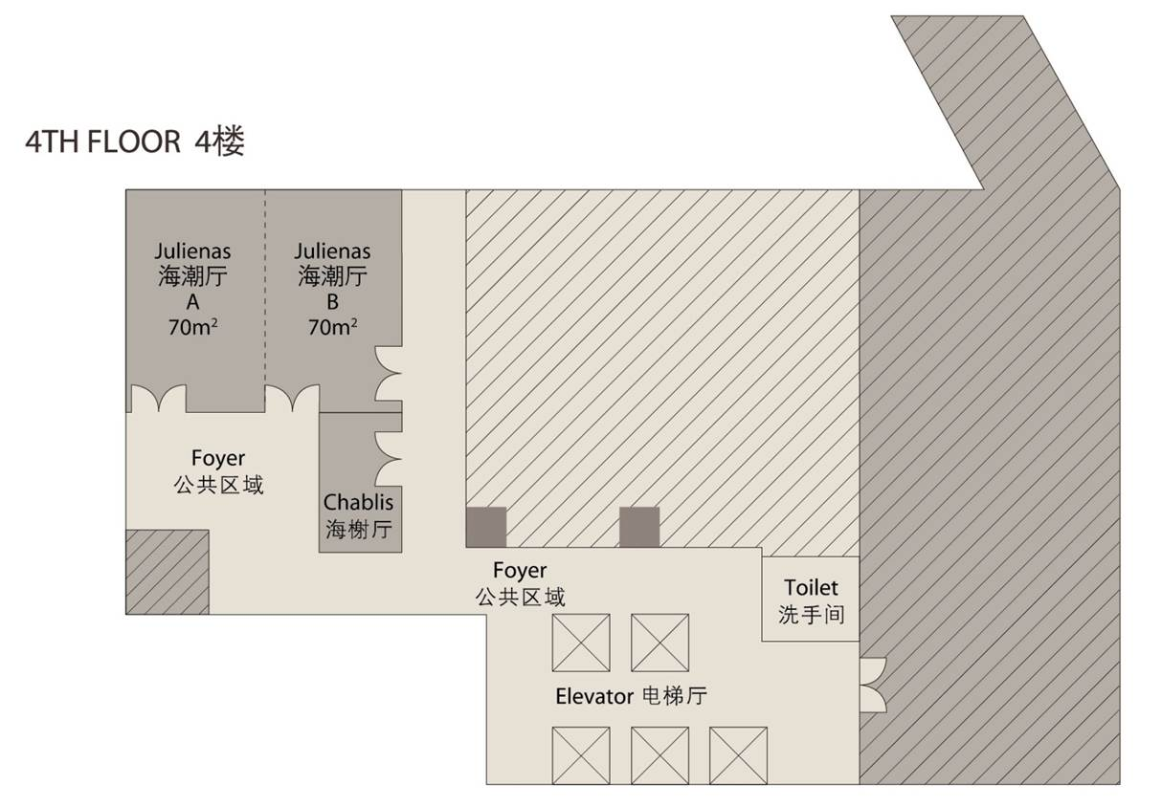
Floor Plan Level 4 楼层规划

Slide 20
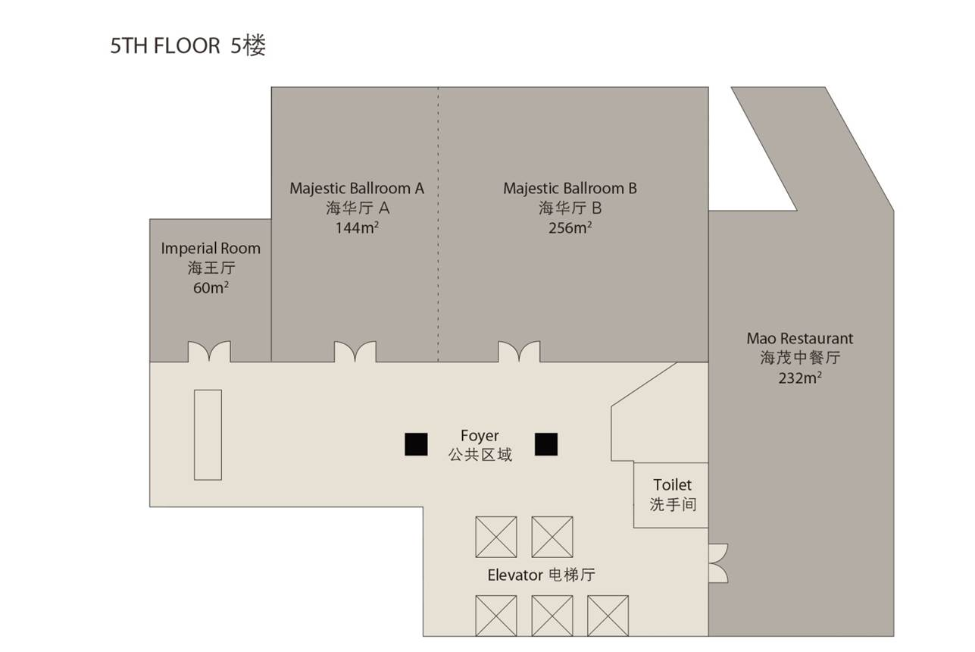
Floor Plan Level 5 楼层规划

Slide 21
The Majestic Ballroom
海华厅
17 . Radisson Collection

Slide 22
Imperial Room
海王厅
17 . Radisson Collection

Slide 23
Julienas Room
海潮厅
17 . Radisson Collection

Slide 24
La Terrasse
泰勒斯天台
17 . Radisson Collection

Slide 25
Relax & Indulge

Slide 26
Fitness Center
健身房
17 . Radisson Collection

